Slide 1



NCRAPS-2023
5th National Conference on "Recent Advancement in Physical Sciences”
Organized by
National Institute of Technology, Uttarakhand
December 19-20, 2023
Paper ID: CHY-03
Development of Superhydrophobic/Oleophilic Fabric using Modified Nanotitania for Oil-water Separation
Presented by
Adeeba
Department of Chemistry Graphic Era (deemed to be) University
Dehradun, Uttarakhand

Slide 2
CONTENTS
BACKGROUND
INTRODUCTION
AIMS AND OBJECTIVE
MATERIALS AND METHODS
RESULTS AND DISCUSSION
CONCLUSION

Slide 3

Background
Sources of Oil Pollution
Textiles industries
Food industries
Petrochemicals industries
Mining industries
13%
11%
4%
13%
32%

Slide 4

INTRODUCTION
Major effects of oil spills.
Human Health
Marine Eco system including animal and plant life
Damage beaches, Marshlands, and Fragile aquatic ecosystems
Recreational and commercial fisheries
Tourism
Toxicity
2

Slide 5
TECHNOLOGIES AVAILABLE FOR OIL WATER SEPARATION
TECHNOLOGIES
DISTILLATION
FLOTATION TECHNOLOGY
SETTLING TANKS
INDUSTRIAL FILTRATION
SKIMMERS
CENTRIFUGATION
MEMBRANE SEPARATION
3

Slide 6



SUPERHYDROPHOBIC/ SUPEROLEOPHILIC COATINGS
Advantages of these coatings in separation of oil water
Enhanced selectivity
Reduced Fouling
Increased Efficiency
Improved oil recovery
Environmental friendly
Fabric
Oil
Water

Slide 7
WHY SOL-GEL METHOD?
Versatility
Customization of Surface Chemistry
Cost Effectiveness
Durability and stability
Resistance to fouling
Easy Implementation
Selective Affinity
4

Slide 8

SOL: TITANIA (${TiO}_{2}$)
Photocatalytic activity
High surface area
Hydrophobicity
Enhanced Wettability control
Durability and Stability
Flexibility in Fabric Choice
Potential for Self-heating coatings
Simple application process
5

Slide 9
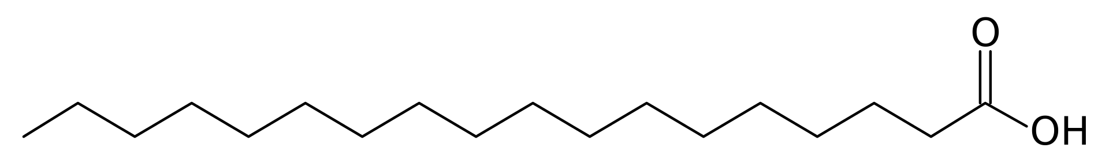
MODIFICATION OF SOL WITH STEARIC ACID
STRUCTURE
octadecanoic acid
PROPERTIES
Biodegradable
Low Volatility (69.3 °C)
Thickening agent
Hydrophobic Nature
Advantages of Magnetite Chitosan composite
Synergistic Effect
Enhanced Stability and Durability
Film formation
Enhanced Hydrophobicity
Improved Oleophilicity
Biocompatibility and Biodegradability
Versatility
Adhesion to Fabric
6

Slide 10

AIM AND OBJECTIVES
AIM: To prepare a Sol for separation of Oil-Water
1
Preparation of Titania Sol and hydrophobic modification using different ratios of stearic acid
2
Characterization of Sol solution using PSA, IR
3
Study of Oil-water separation efficiency
Study of Oil-Water separation efficiency

Slide 11
Method for preparation of Titania Sol Solution and its Modification
Method adopted: Sol-gel method via Acid hydrolysis
Steps involved:
Distilled Water
+
Ethanol
Stearic Acid
+
Ethanol
- - - - - - -
- - - - - - -
- - - - - - -
- - - - - - -
- - - - - - -
- - - - - - -
- - - - - - -
- - - - - - -
- - - - - - -
- - - - - - -
- - - - - - -
- - - - - - -
Acetic acid
+
Ethanol
Acified TTIP/
Ethanol Solution
Titania Sol
TTIP
+
Ethanol
- - - - - -
- - - - - -
- - - - - -
- - - - - -
- - - - - -
- - - - - -
- - - - - -
- - - - - -
- - - - - -
- - - - - -
- - - - - -
- - - - - -
For 15 mins
For 3 hours
For 2 days
- - - - - -
- - - - - -
- - - - - -
- - - - - -
Magnetic Stirrer
Magnetic Stirrer
Magnetic Stirrer
Modified Titania Sol
11
Fig1 : Preparation and modification of titania sol

Slide 12
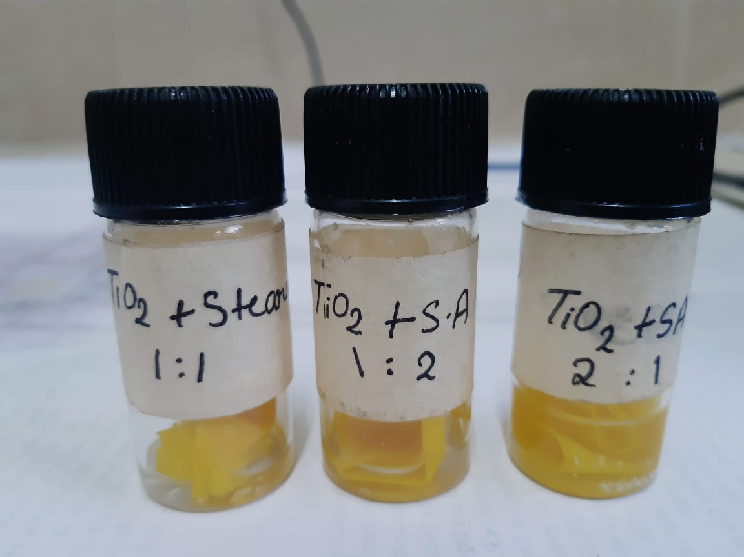











































Coating on Fabric
Dip coating method
Coating on fabric
Uncoated fabric
Hydrophobically modified nanostructured fabric
Modified Titania Sol
Fig 2: Schematic representation of coating of nano-sol solution on fabric substrate
12

Slide 13
CHARACTERIZATION

Slide 14
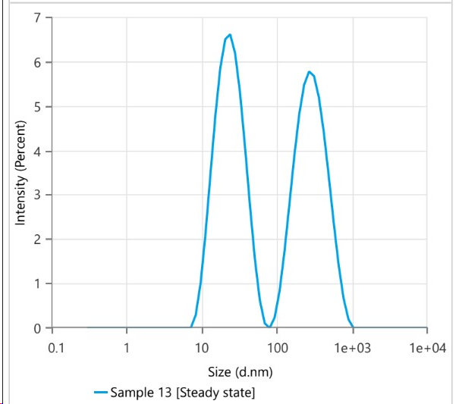
Particle Size Analysis (PSA)
RESULTS REVEAL THAT:
Size is 39.5 nm
Polydispersity Index is 0.725
Fig 3: PSA of Titania sol

Slide 15
FE-SEM ANALYSIS
Uncoated Fabric
Coated
Fabric
Fig 4: FE-SEM images of Uncoated and Coated fabric
RESULTS REVEAL THAT:
Roughness
Every single thread is coated
Nano sized 30-40 nm approximately
13

Slide 16
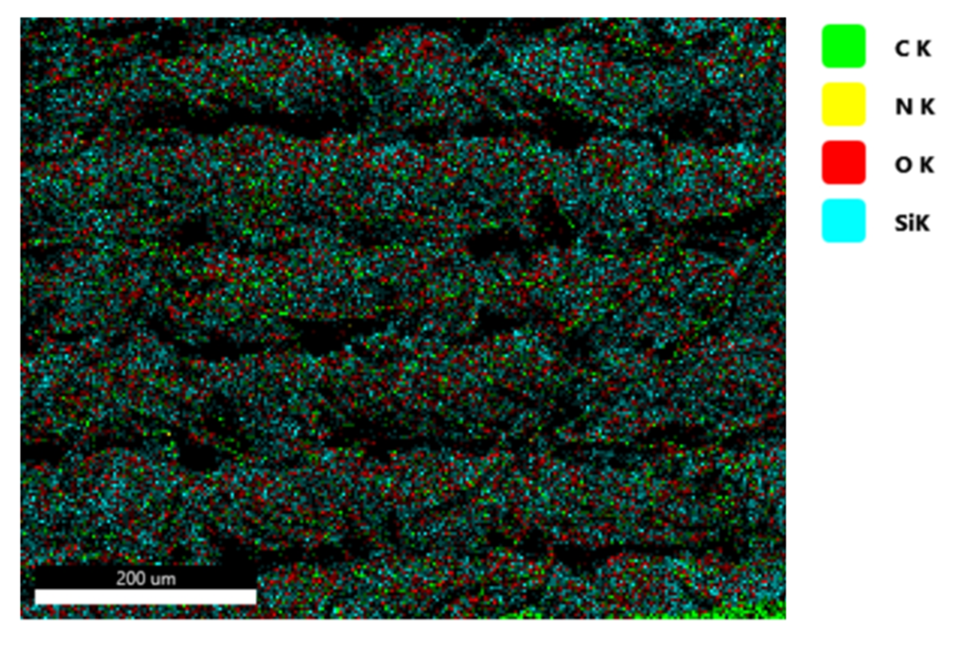
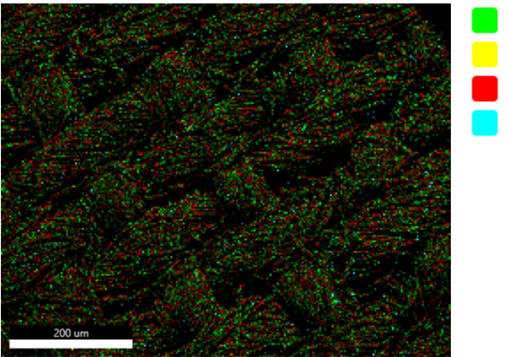

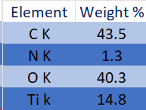
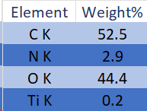
FE-SEM EDX ANALYSIS
a
C K
b
C K
N K
N K
O K
O K
Ti K
Ti K
Fig 5: a) is showing the FE-SEM EDX of uncoated fabric
b) is showing the FE-SEM EDX of coated fabric

Slide 17
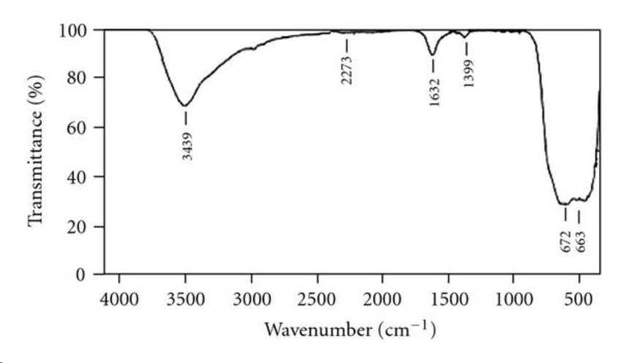
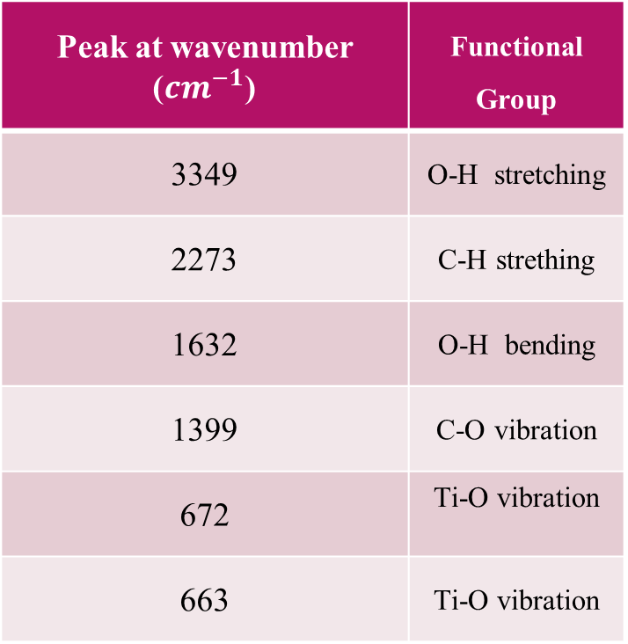
FTIR ANALYSIS
Peak at wavenumber (${cm}^{−1}$) | Functional Group
3349 | O-H stretching
2273 | C-H strething
1632 | O-H bending
1399 | C-O vibration
672 | Ti-O vibration
663 | Ti-O vibration
RESULTS ARE:
Figure 6: FTIR spectra of Titania Sol
13

Slide 18
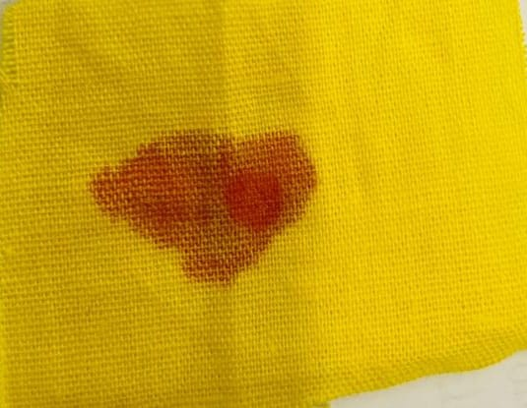
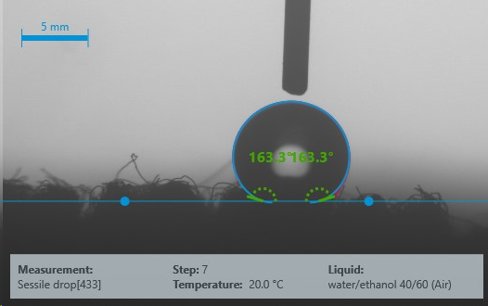
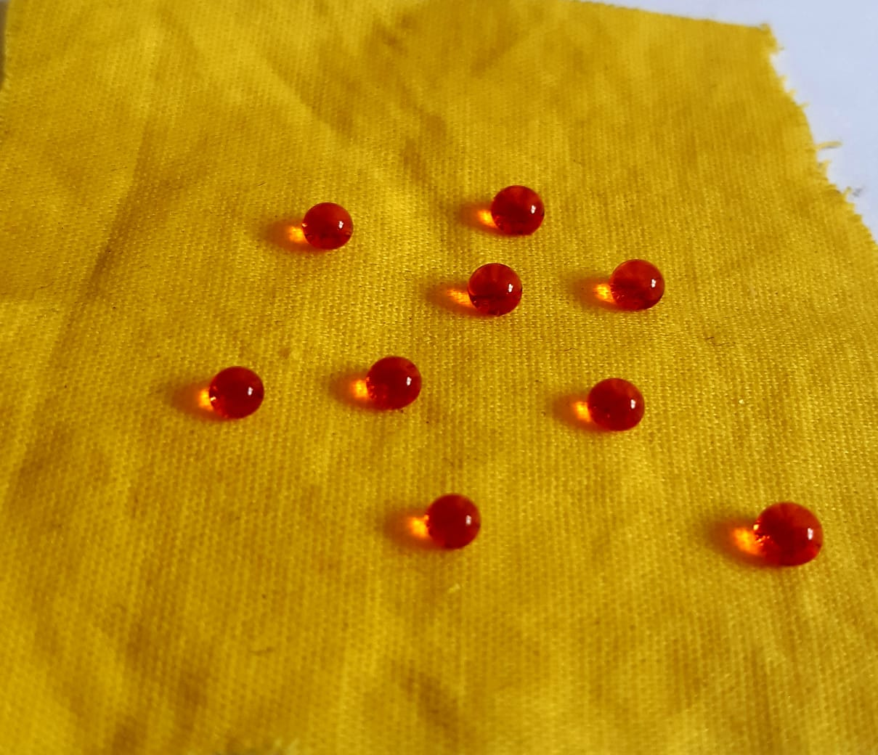
Water Contact Angle (WCA)
Uncoated fabric
Coated fabric
RESULTS REVEAL THAT:
Contact angle is 163.3º
Showing superhydrophobicity

Slide 19
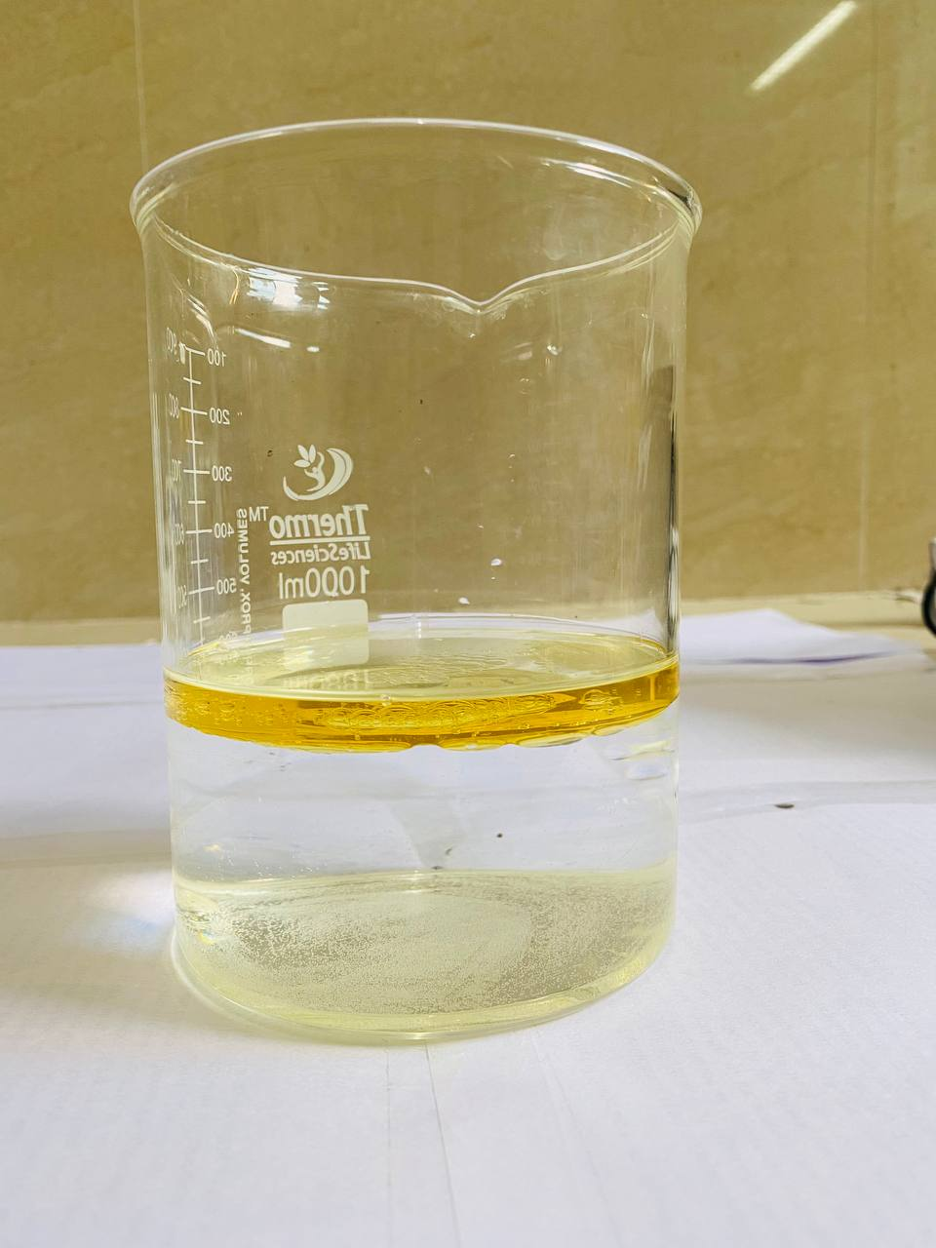
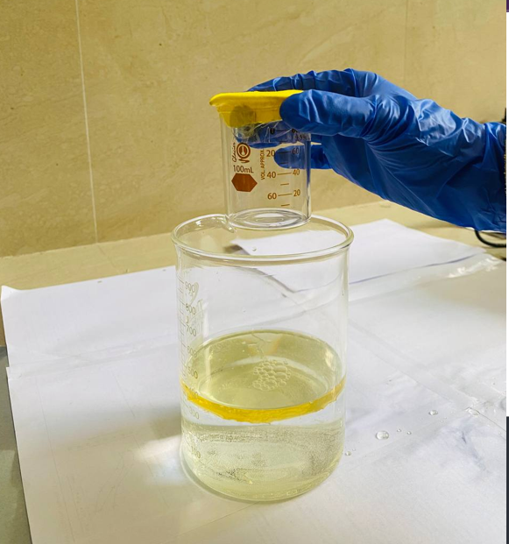
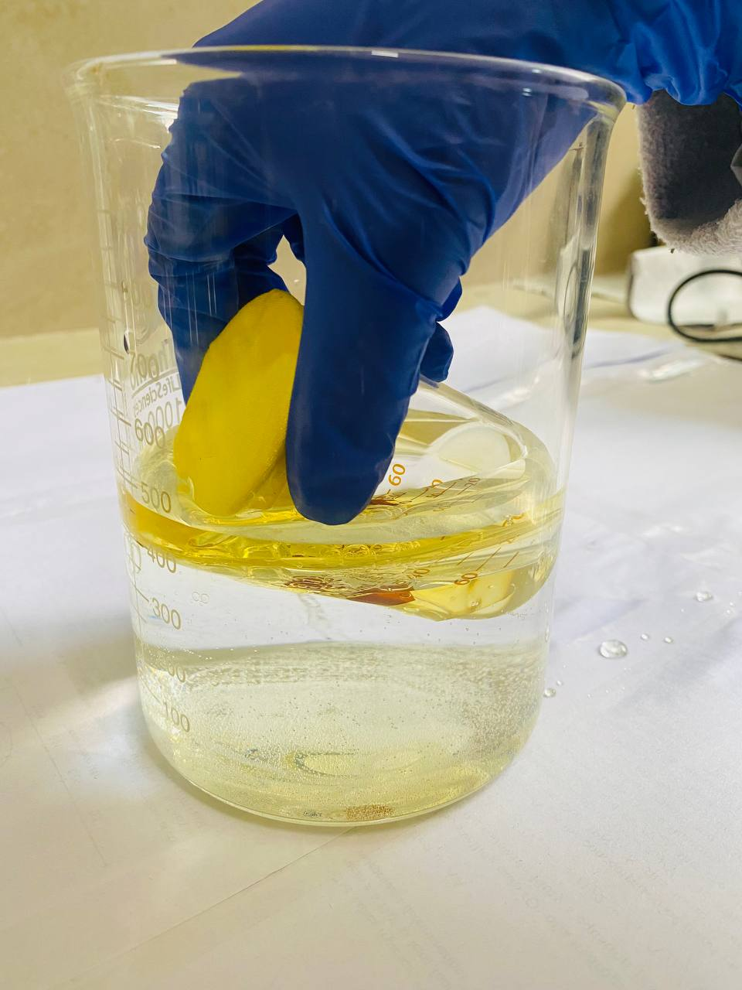
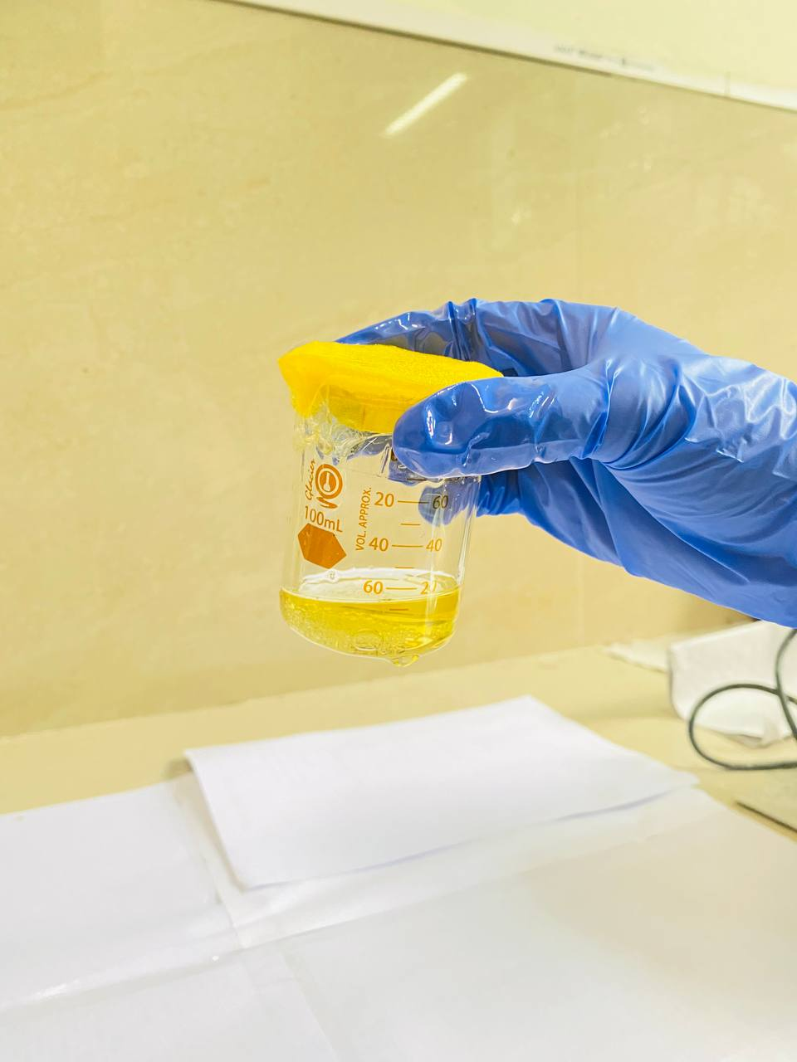
OIL-WATER SEPARATION METHOD
Method Used
a
b
c
d

Slide 20
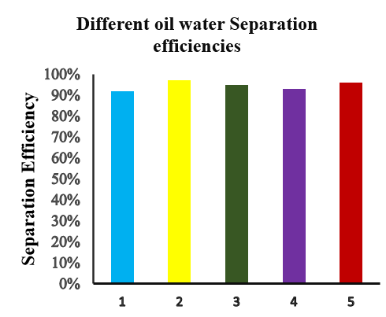
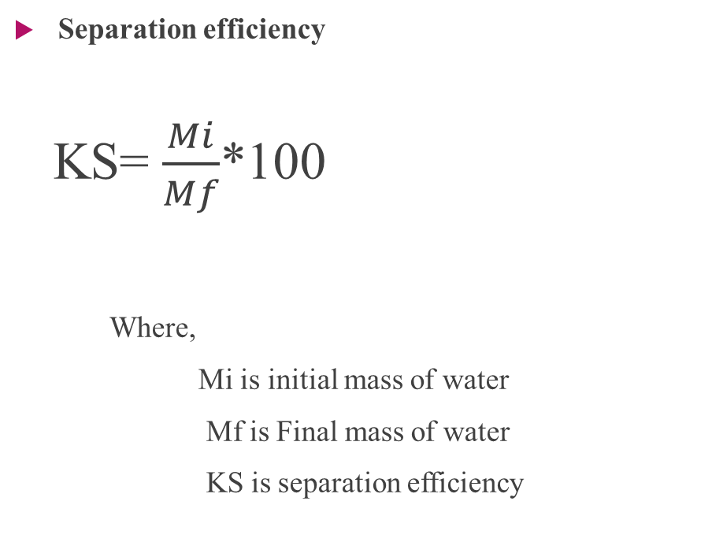
OIL-WATER SEPARATION METHOD
Separation efficiency
KS= $\frac{Mi}{Mf}$*100
Where,
Mi is initial mass of water
Mf is Final mass of water
KS is separation efficiency
97%
92%
94%
95%
93%
Toluene
Chloroform
Coconut Oil
Olive Oil
Sunflower Oil

Slide 21
CONCLUSION
FTIR results revealed the successful fabrication of Titania Sol
Nano structured present on coated surface was confirmed by SEM
Superhydrophobicity of coated fabric was showing by WCA
97% is the highest oil separation efficiency of coated fabric for removal of chloroform.

Slide 22
THANK YOU

